Slide 1


CAPSTONE PROJECT
PROJECT TITLE
Presented By
Student Name: Jahnavi.m
College Name: Seshadripuram academy of Business Studies
Department: Computer Science
Email ID:
jahnavi3514@gmail.com

Slide 2
OUTLINE:
Problem Statement (Should not include solution)
Proposed System/Solution
System Development Approach (Technology Used)
Algorithm & Deployment
Result (Output Image)
Conclusion
Future Scope
References

Slide 3
Problem Statement:
Hospitality businesses generate large volumes of booking and revenue data.
Decision-makers lack a single, consolidated view to monitor performance.
Difficulty in tracking:
Revenue trends
Occupancy utilization
Cancellations and booking behavior
City and category-wise performance
Manual reporting is time-consuming and inefficient.

Slide 4
Proposed Solution:
Design an interactive Power BI dashboard to analyze hotel performance.
Integrate booking, revenue, room, and date data into a single model.
Provide real-time insights using:
KPIs
Trend analysis
Category and city-level comparisons
Enable filtering using slicers for better decision-making.

Slide 5
System Approach:
Approach Used: Business Intelligence & Data Analytics
Steps:
Data Collection (CSV files)
Data Cleaning & Transformation (Power Query)
Data Modeling (Star Schema)
DAX Measures Creation
Dashboard Design & Visualization
Tool: Microsoft Power BI Desktop
Language: DAX (Data Analysis Expressions)
Data Format: CSV Files
Visualization Types:
KPI Cards
Line Charts
Clustered Column Charts
Donut Chart
Slicers

Slide 6
Algorithm & Deployment:
Algorithm Used (Business Logic using DAX)
This project does not use machine learning algorithms.
Business logic is implemented using DAX measures in Power BI.
DAX functions such as SUM, COUNT, AVERAGE, CALCULATE, DIVIDE are used.
These measures dynamically calculate:
  Total Revenue
  Total Bookings
  Occupancy Percentage
  Cancellation Rate
  Average Customer Rating
  Working of the Algorithm
Raw booking data is filtered using slicers.
DAX measures recalculate KPIs in real time.
Aggregations are performed based on city, category, room class, and date.
Deployment
The final dashboard is developed in Power BI Desktop.
Dashboard can be published to Power BI Service.
End users can access insights through interactive visuals and filters.
The solution is scalable and can be extended with real-time data.

Slide 7
DATASET OVERVIEW
Tables Used:
dim_date
dim_hotels
dim_rooms
fact_bookings
fact_aggregated_bookings
Key Attributes:
City, Hotel Category, Room Class
Booking Status
Revenue Generated & Realized
Occupancy & Capacity
Key Metrics (DAX MEASURES)
Total Revenue
Total Bookings
Occupancy %
Cancellation Rate %
Average Rating
These measures dynamically update based on slicer selection.

Slide 8
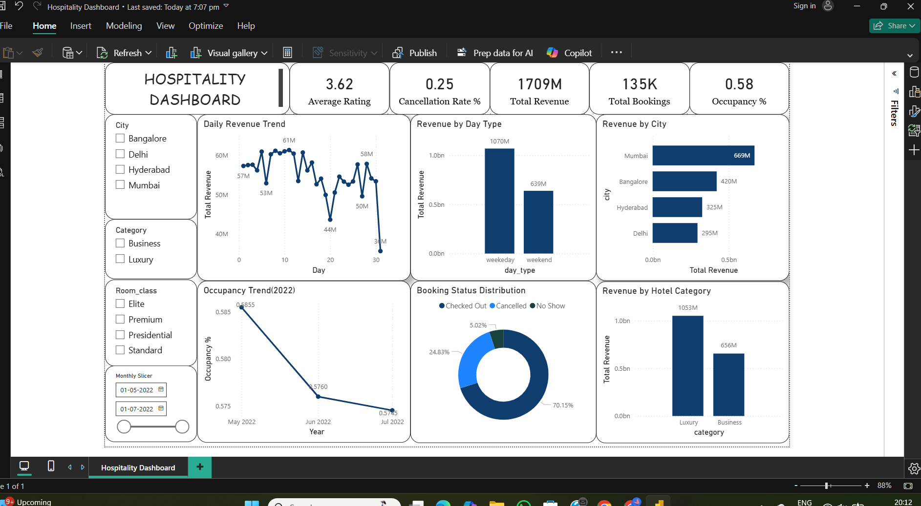
Result:
Dashboard Highlights:
One-page executive dashboard
KPI summary at the top
Revenue and occupancy trends
City-wise and category-wise analysis
Booking status distribution

Slide 9
Conclusion:
The Power BI dashboard provides a clear and interactive view of hospitality performance.
Helps stakeholders monitor revenue, occupancy, and customer behavior.
Reduces dependency on manual reports.
Enables faster and data-driven decision-making.

Slide 10
Future scope:
Add predictive analytics for demand forecasting.
Integrate real-time data sources.
Include cost and profit analysis.
Expand dashboard for multiple hotel chains or regions.

Slide 11
References:
Microsoft Power BI Official Documentation
Microsoft DAX Reference Guide
Power BI Data Modeling and Visualization Best Practices
Hospitality Analytics and Business Intelligence Case Studies
Online learning resources and tutorials related to Power BI dashboards
GITHUB Link:

Slide 12
Thank You

